Slide 1
Quantum stochastic gradient descent methods（QSGD） in the distributed perspective
①
②
③
Distributed Partial Quantum Consensus of Qubit Networks With Connected Topologies
Stability analysis of quantum systems: A Lyapunov criterion and an invariance principle
Learning to Learn Variational Quantum Algorithm
④
⑤
Towards provably efficient quantum algorithms for large-scale machine learning models
Entanglement-Controlled Quantum Federated Learning
CPS Computational Learning Laboratory
Notes:
首先介绍第一篇

Slide 2

②
Stability analysis of quantum systems: A Lyapunov criterion and an invariance principle
Distributed Quantum Coding Consistency
①
③
Distributed Partial Quantum Consensus of Qubit Networks With Connected Topologies
Learning to Learn Variational Quantum Algorithm
QSGD algorithm
④
⑤
Towards provably efficient quantum algorithms for large-scale machine learning models
Scaling to Distributed
Systems
Entanglement-Controlled Quantum Federated Learning
CPS Computational Learning Laboratory
Notes:
首先介绍第一篇

Slide 3
Paper 1
Distributed Partial Quantum Consensus of Qubit
Networks With Connected Topologies
Xin Jin , Zhu Cao , Yang Tang, and Jürgen Kurths
Publish Journal: IEEE TRANSACTIONS ON CYBERNETICS (TCYB-2025)
CPS Computational Learning Laboratory
Notes:
这篇论文提出了一种多动作深度强化学习算法解决FJSP

Slide 4
01
Problem Description
02
Method Design
03
Experiment Results
Contents
04
Conclusion
CPS Computational Learning Laboratory
Notes:
首先是问题描述

Slide 5
Problem Description
Distributed implementation of quantum consensus protocols in large-scale quantum networks
This study design quantum operations based on local information so that each quantum bit only interacts with its neighbors, which avoids the computational burden of global operations and improves the feasibility of the scheme in large-scale quantum networks..
Challenge
Existing quantum consensus protocols are difficult to implement distributedly in large-scale quantum networks.
The number of quantum bits in the distributed quantum consensus problem grows exponentially with the number of nodes, making the computational burden increase.
Method
By designing Hamiltonian quantities and designing quantum Lyapunov control protocols based on local information, each quantum bit is able to reach consensus relying only on neighbor information.
CPS Computational Learning Laboratory
Notes:
量子共识协议在大规模量子网络中分布式实现的问题：
本文研究了量子比特网络的部分量子共识问题，基于每个量子系统的局部信息设计局部量子操作，通过构建酉变换实现部分量子共识，即量子态在布洛赫球上的方向达成一致。
1.现有量子共识协议难以在大规模量子网络中分布式实现的问题
2.分布式量子共识问题的量子比特数随节点数量增加呈指数级增长，使得计算负担增大
通过设计哈密顿量和基于局部信息的量子李亚普诺夫控制协议，每个量子比特都能仅依靠邻居信息达成共识。

Slide 6
01
Problem Description
02
Method Design
03
Experiment Results
Contents
04
Conclusion
CPS Computational Learning Laboratory

Slide 7
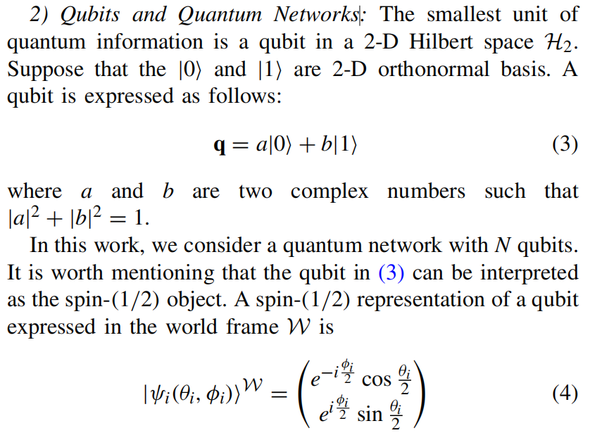
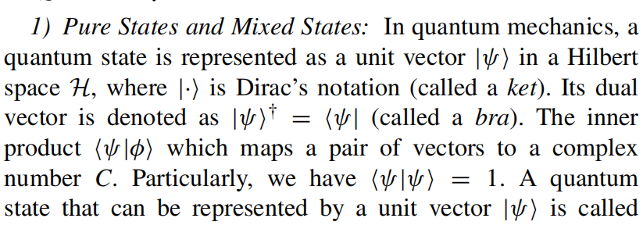
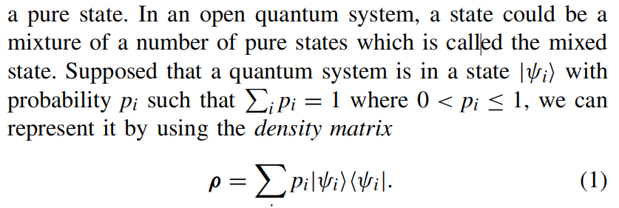
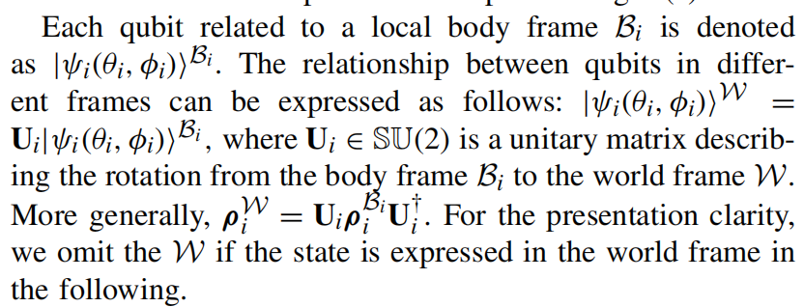
Method Design
① Quantum systems:
注：通过幺正变换建立全局混合态
与局部混合态联系
CPS Computational Learning Laboratory

Slide 8
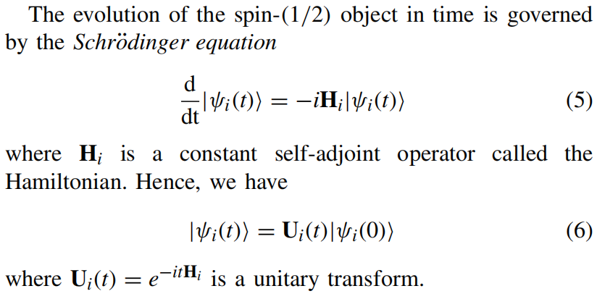
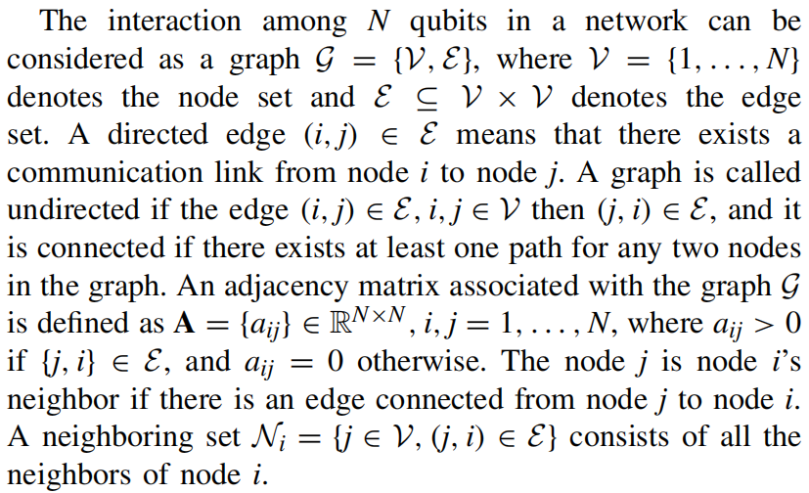
Method Design
②Spin state:
③Distributed graph theory:
CPS Computational Learning Laboratory

Slide 9
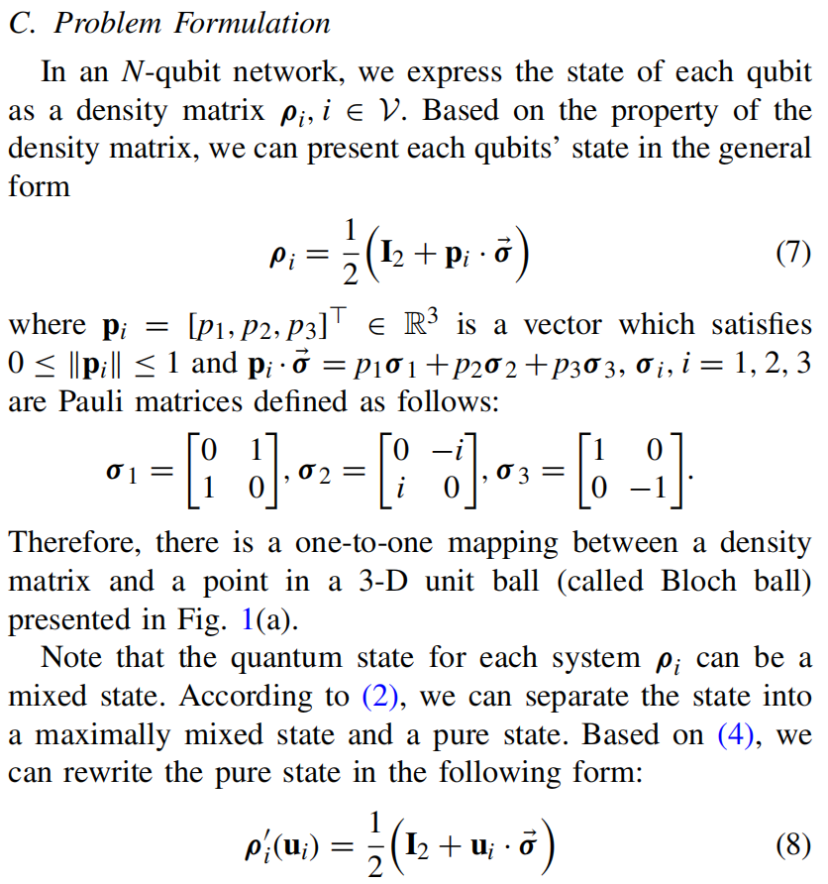
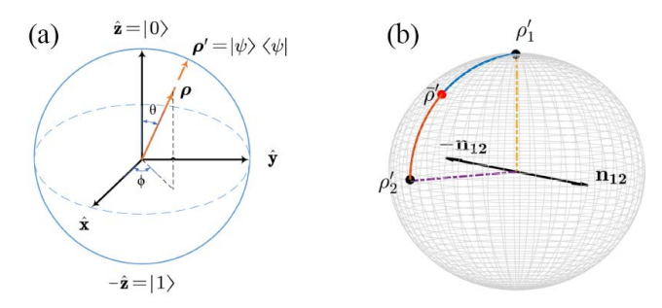
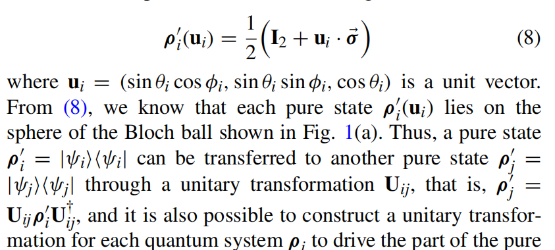
Method Design
注：将密度矩阵一般化为泡利矩阵线性组合形式。
且与布洛赫球的三维坐标一一对应。
通过球坐标变换
将式（8）扩展为自旋态形式
CPS Computational Learning Laboratory

Slide 10
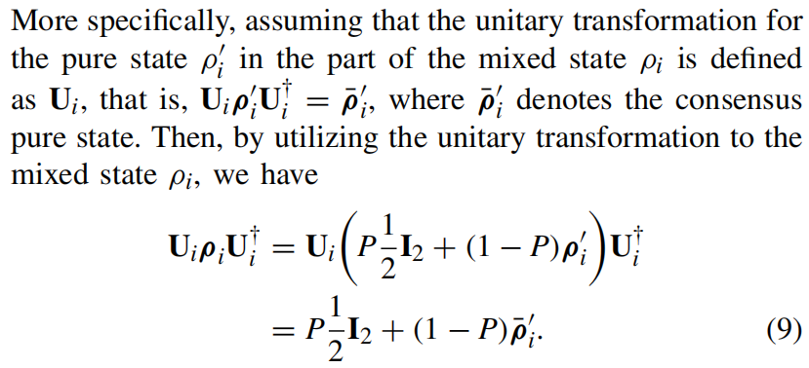
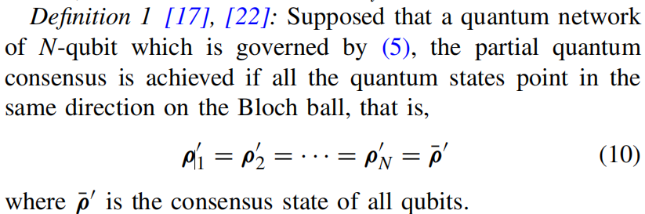
Method Design
定义：多量子比特的局部量子共识
建立共识状态下的量子纯态
CPS Computational Learning Laboratory
Notes:
从(9)式可知，基于酉变换Ui，纯态ρi达到了共识。这使我们能够仅对混合态ρi的纯态ρi部分设计幺正变换，以实现定义1中所定义的部分量子共识。我们将把量子比特网络中交互式哈密顿量Hi，i = 1，...，N称为量子协议。

Slide 11
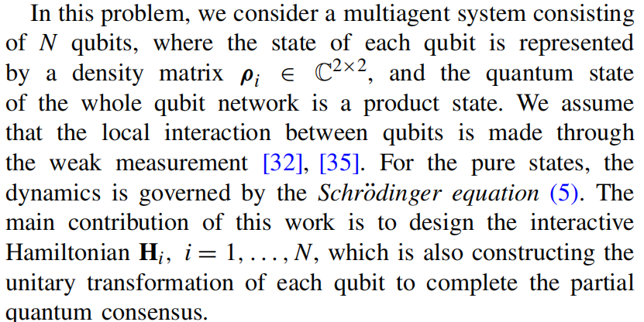
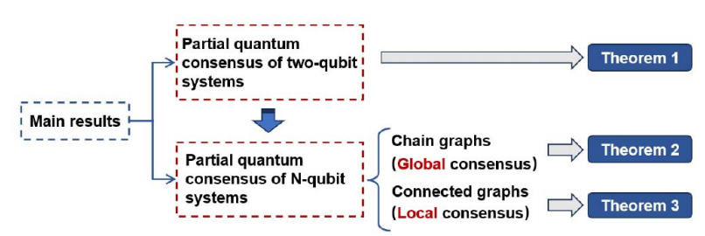
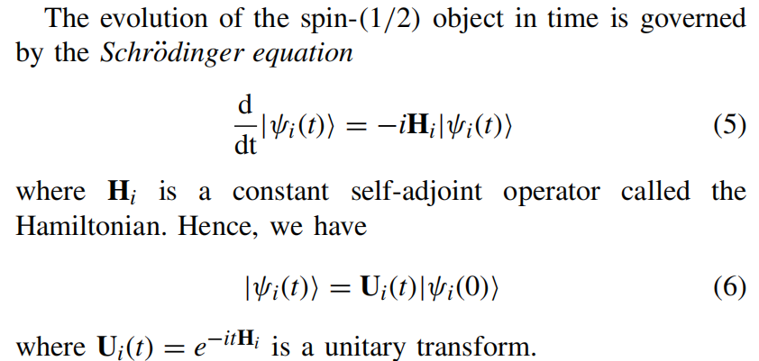

Method Design
问题描述：考虑多量子节点包含N个量子比特，在弱测量下（在观测时不影响量子状态）通过控制哈密顿量实现多量子比特的局部量子共识。
双量子比特量子共识
多量子比特全局量子共识
多量子比特局部量子共识
CPS Computational Learning Laboratory

Slide 12
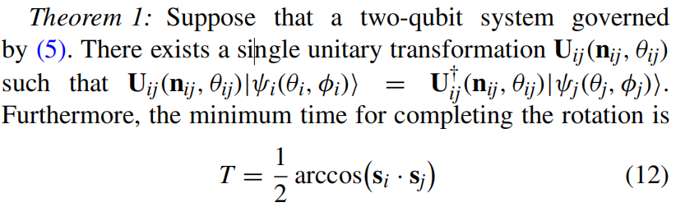
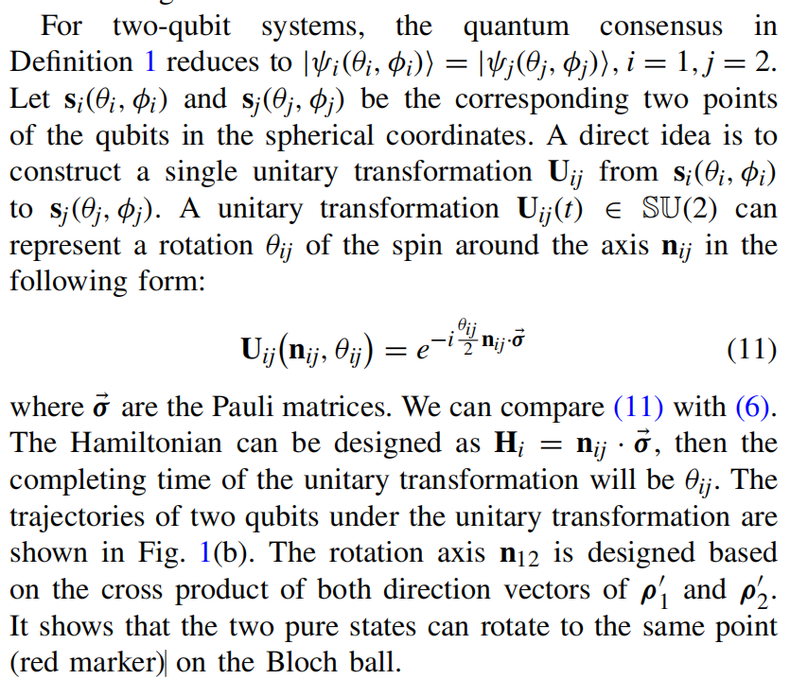
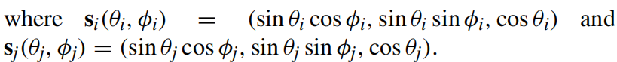
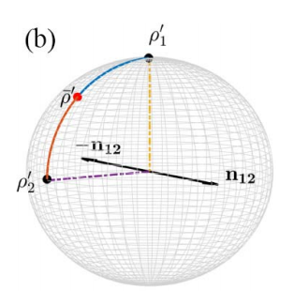

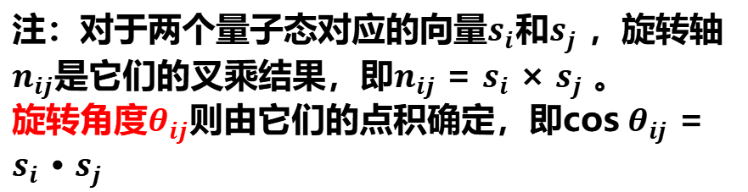
Method Design
（1）对于双量子比特共识：
注：对于两个量子态对应的向量$s_{i}$和$s_{j}$ ，旋转轴$n_{ij}$是它们的叉乘结果，即$n_{ij}$ = $s_{i}$ × $s_{j}$ 。
旋转角度$θ_{ij}$则由它们的点积确定，即cos $θ_{ij}$ = $s_{i}$ · $s_{j}$
CPS Computational Learning Laboratory
Notes:
对于两量子系统，量子共识要求它们的量子态在布洛赫球上指向同一方向。基于量子态的几何构型，可以通过构造一个旋转操作来实现这一目标。这个旋转操作是由两个量子态的方向向量所确定的平面的法向量来设计的。

Slide 13
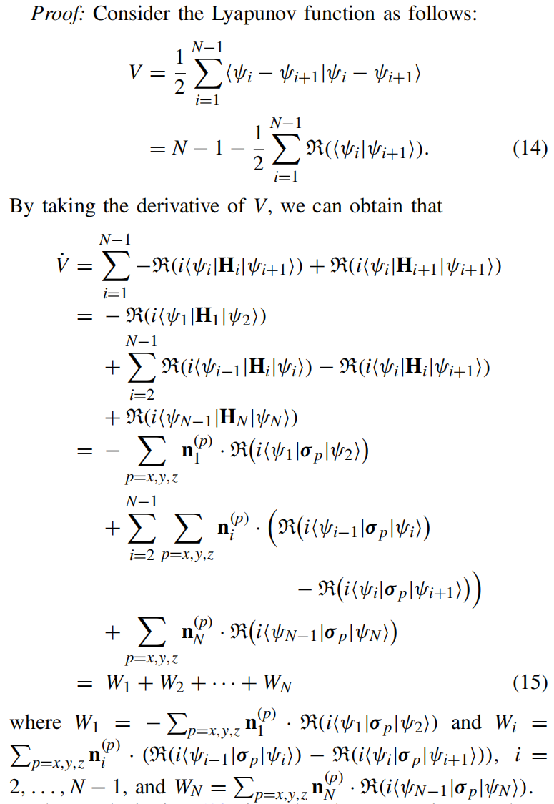
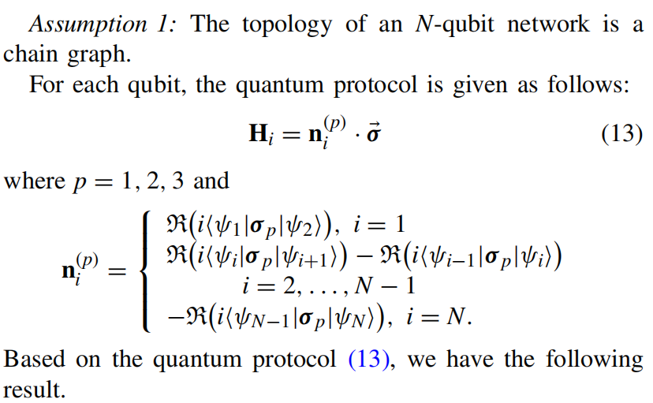

Method Design
（2）对于多量子比特在链式图的全局量子共识：
注：链式拓扑结构的共识矢量方程（从前到后）
CPS Computational Learning Laboratory

Slide 14
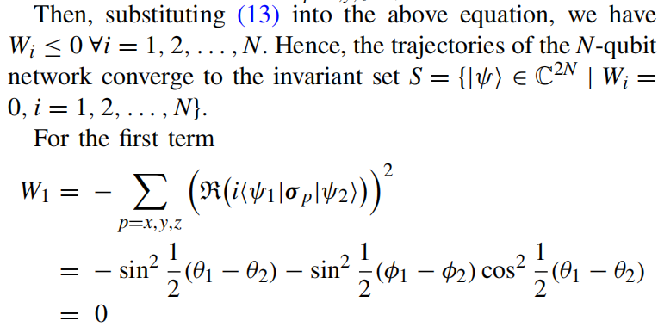
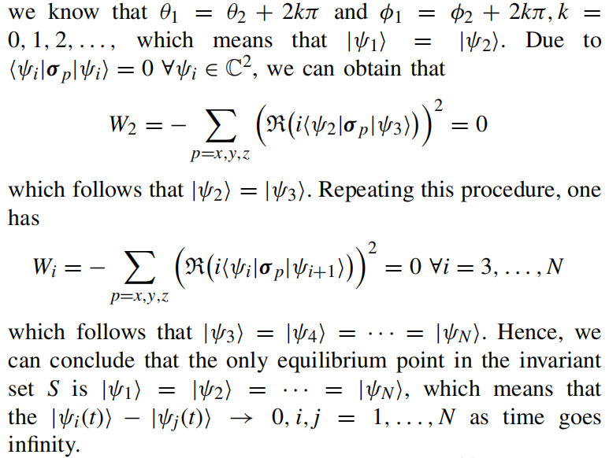


Method Design
拉塞尔不变集原理
注：从前到后递推，可以推得所有节点量子态一致性收敛
CPS Computational Learning Laboratory

Slide 15
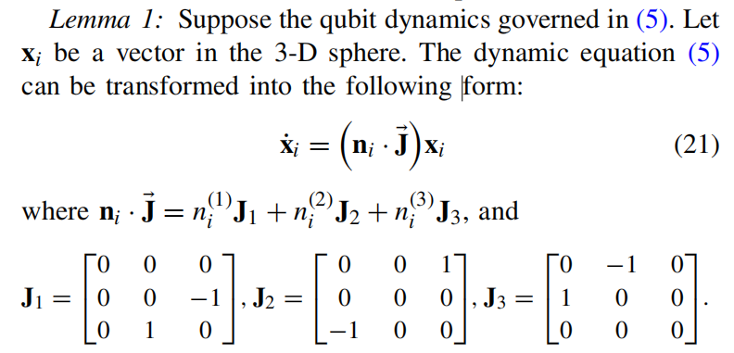
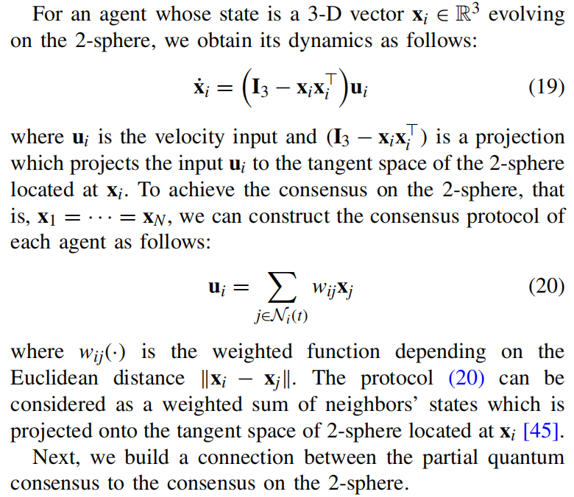
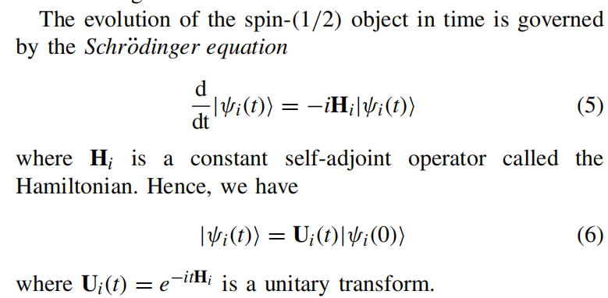
Method Design
（2）对于多量子比特在连通图的局部信息量子共识：
注：将幺正变换的二维矩阵直接扩展为三维形式
CPS Computational Learning Laboratory
Notes:
在连通图的情况下，很难推导出哈密顿量，以保证不变集S只包含一致点。这两个方向向量对应于布洛赫球上的两个量子态，这一事实启发我们从几何的角度研究量子共识协议

Slide 16
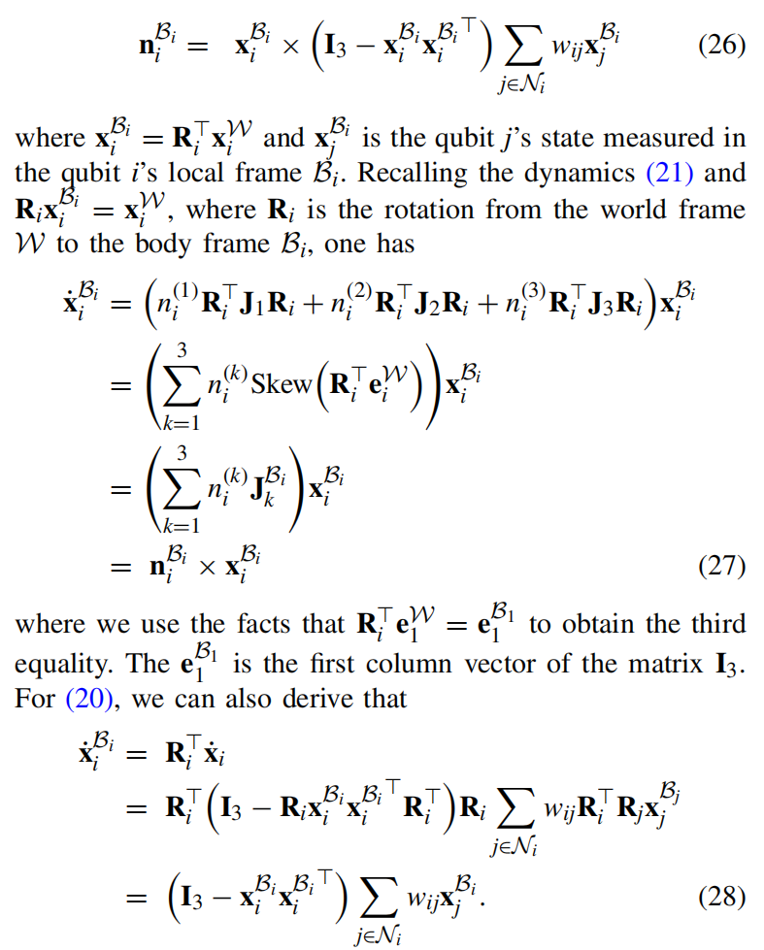
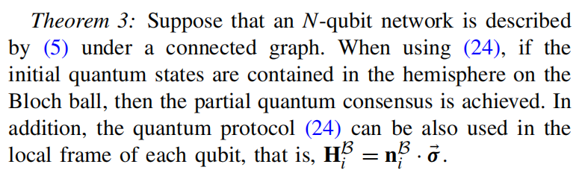
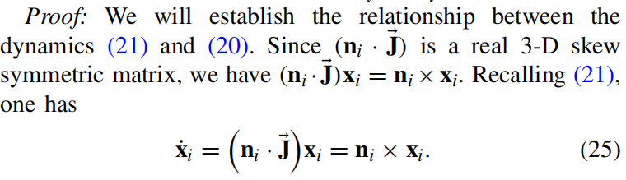
Method Design
（2）对于多量子比特在连通图的局部信息量子共识：
CPS Computational Learning Laboratory
Notes:
在连通图的情况下，很难推导出哈密顿量，以保证不变集S只包含一致点。这两个方向向量对应于布洛赫球上的两个量子态，这一事实启发我们从几何的角度研究量子共识协议

Slide 17
01
Problem Description
02
Method Design
03
Experiment Results
Contents
04
Conclusion
CPS Computational Learning Laboratory

Slide 18
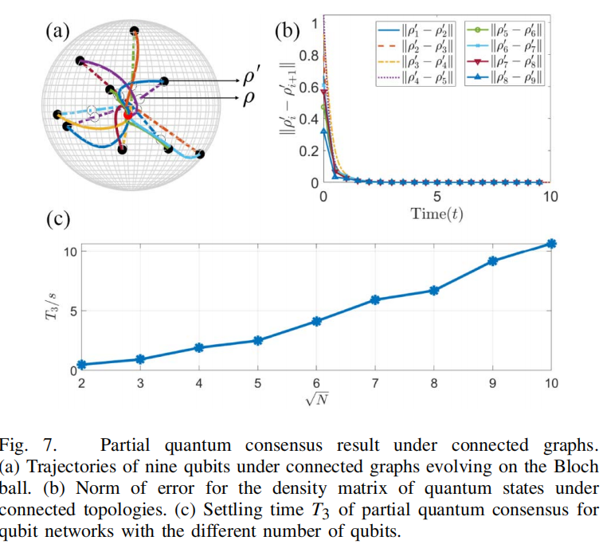
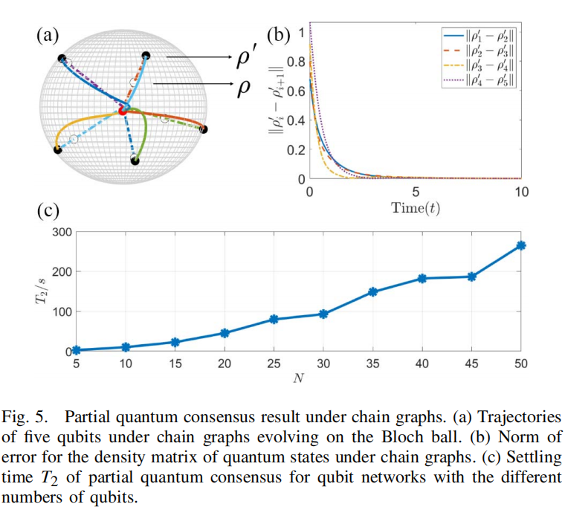
Experiment Results
CPS Computational Learning Laboratory

Slide 19
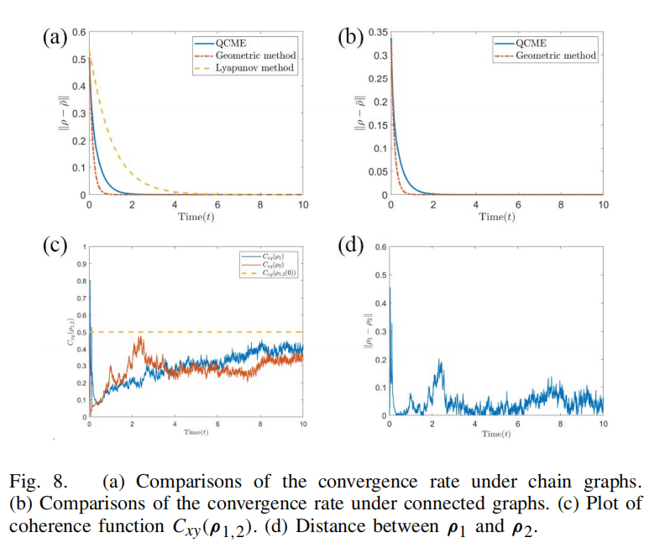
Experiment Results
CPS Computational Learning Laboratory

Slide 20
01
Problem Description
02
Method Design
03
Experiment Results
Contents
04
Conclusion
CPS Computational Learning Laboratory
CPS Computational Learning Laboratory
2
18

Slide 21
Conclusion
①
This paper based on the convexity property of the density matrix, construct the unitary transformation for each quantum system to drive the part of pure states to consensus.
②
This paper based on the Lyapunov method to design the Hamiltonian for each quantum system, and extend the approaches to the more general N-qubit networks.
CPS Computational Learning Laboratory

Slide 22
Paper 2
Stability analysis of quantum systems: A Lyapunov criterion and an
invariance principle
Muhammad Fuady Emzir, Matthew J. Woolley, Ian R. Petersen
Publish Journal: Automatica
Published Time: 2022
CPS Computational Learning Laboratory

Slide 23
01
Problem Description
02
Method Design
03
Experiment Results
Contents
04
Conclusion
CPS Computational Learning Laboratory
Notes:
主要分为以下四个部分

Slide 24
01
Problem Description
02
Method Design
03
Experiment Results
Contents
04
Conclusion
CPS Computational Learning Laboratory
Notes:
首先是问题描述

Slide 25
Problem Description
The Lyapunov stability of quantum dynamical semigroups
In this paper, we will introduce a Lyapunov stability concept for quantum system invariant density operators. By approach infers the stability of the density operator of a quantum system by constructing a candidate Lyapunov operator and analyzing the properties of its generating elements.
Method:
The stability of density operators for quantum systems is inferred by constructing candidate Lyapunov operators and analyzing the properties of their generating elements. The problem of how to analyze the convergence of density operators for open quantum systems is solved, providing a new theoretical tool for the control and stabilization of quantum systems.
CPS Computational Learning Laboratory
Notes:
论文提出了一种类似于经典控制理论中Lyapunov方法的稳定性分析方法，用于量子系统的密度算符。这种方法通过构造一个候选Lyapunov算符，分析其生成元的性质，来推断量子系统密度算符的稳定性。解决了如何分析量子系统密度算符收敛性的问题，为量子系统的控制与稳定提供了新的理论工具。

Slide 26
01
Problem Description
02
Method Design
03
Experiment Results
Contents
04
Conclusion
CPS Computational Learning Laboratory
Notes:
研究现状

Slide 27
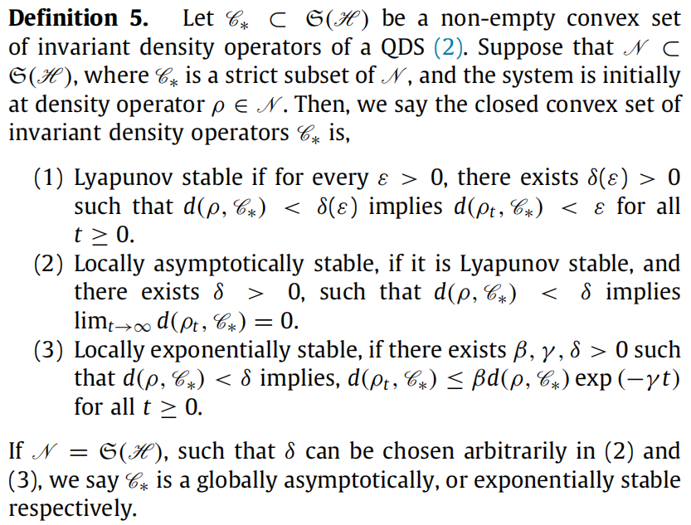
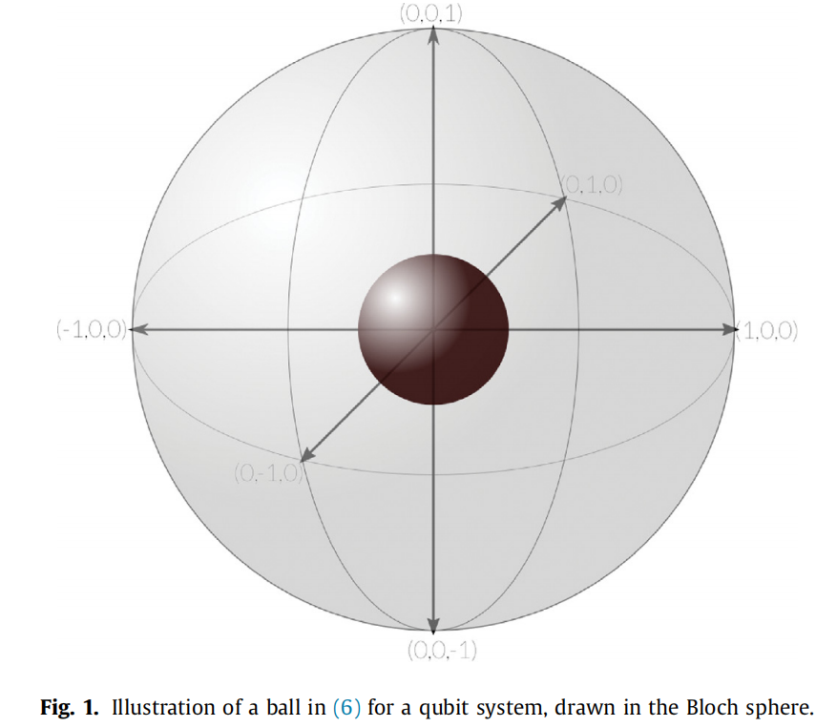
Method Design
量子系统（密度算符）在lyapunov准则稳定的定义
CPS Computational Learning Laboratory

Slide 28
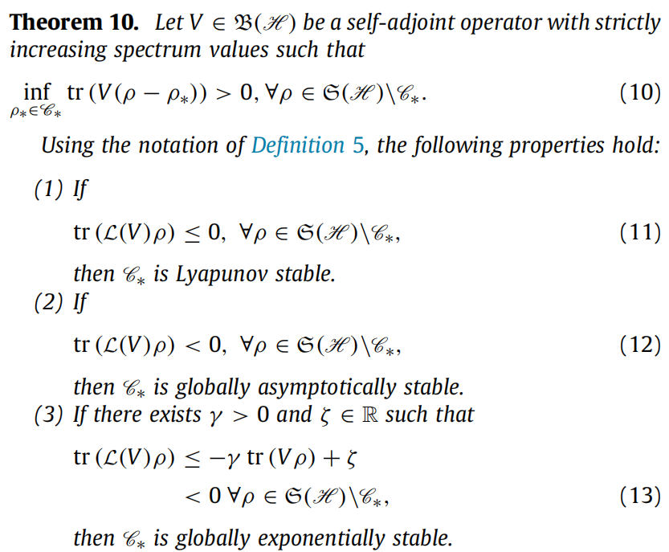
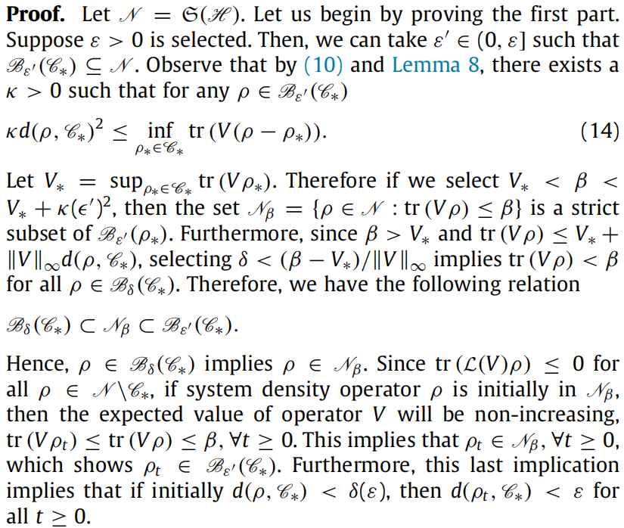
Method Design
CPS Computational Learning Laboratory

Slide 29
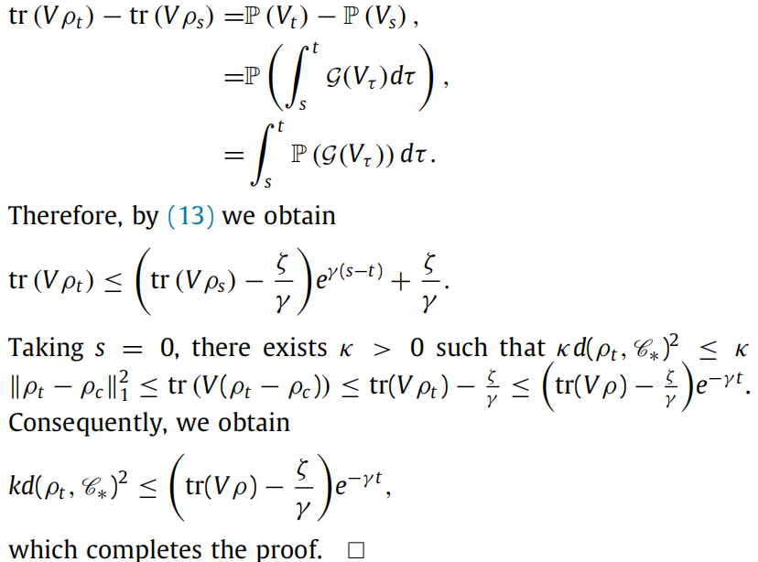
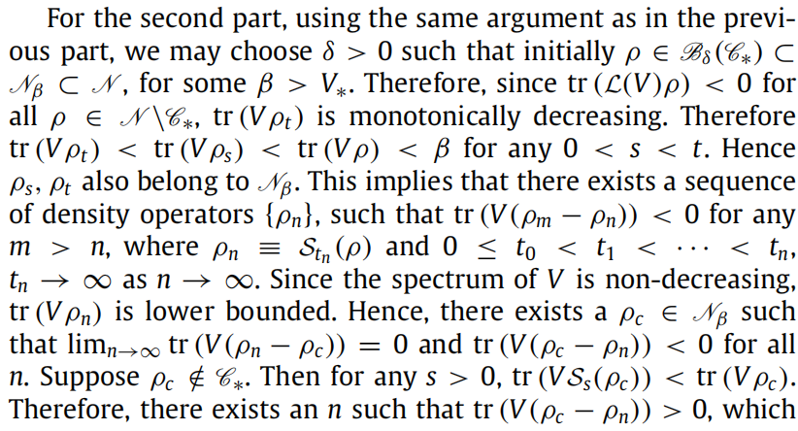
Method Design
CPS Computational Learning Laboratory

Slide 30
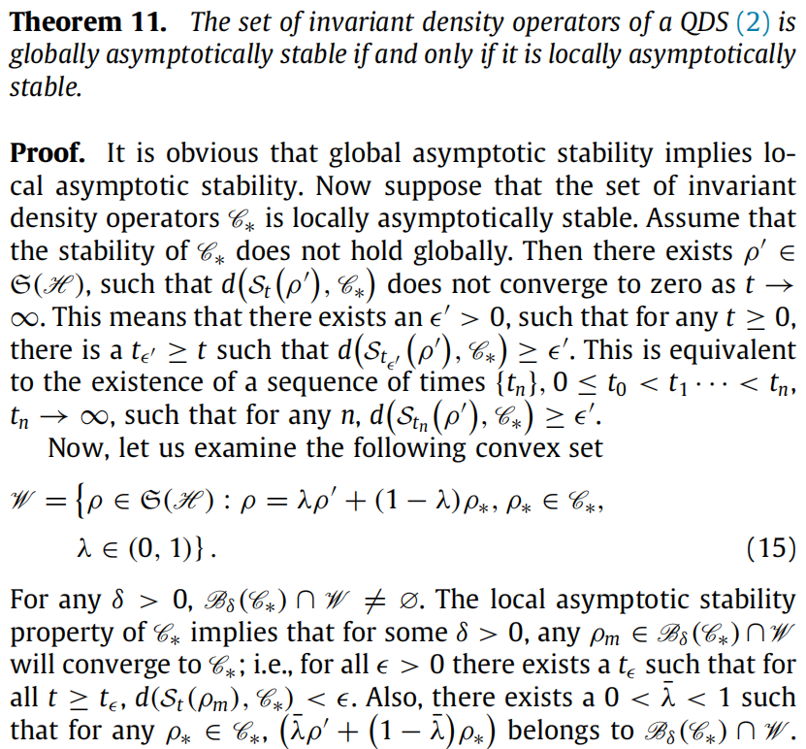
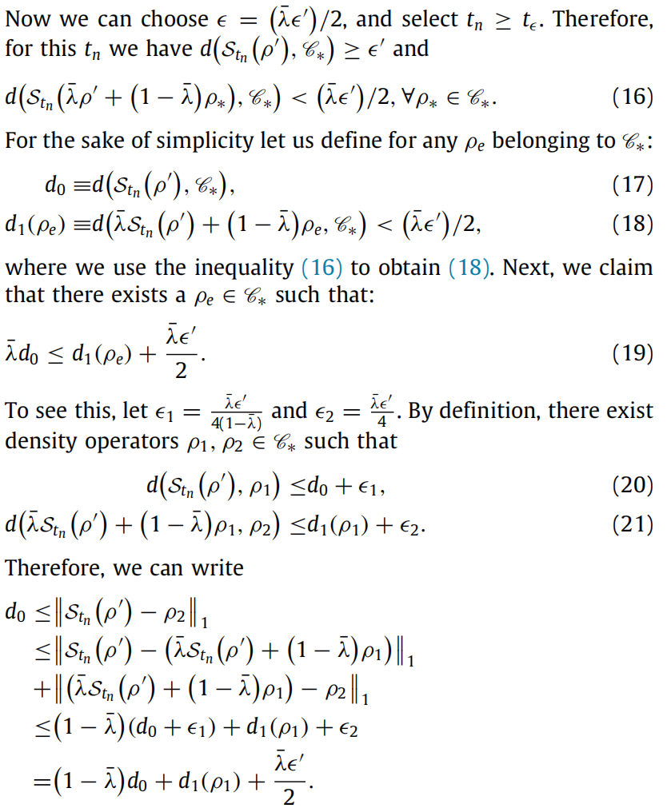
Method Design
CPS Computational Learning Laboratory

Slide 31
01
Problem Description
02
Method Design
03
Experiment Results
Contents
04
Conclusion
CPS Computational Learning Laboratory

Slide 32
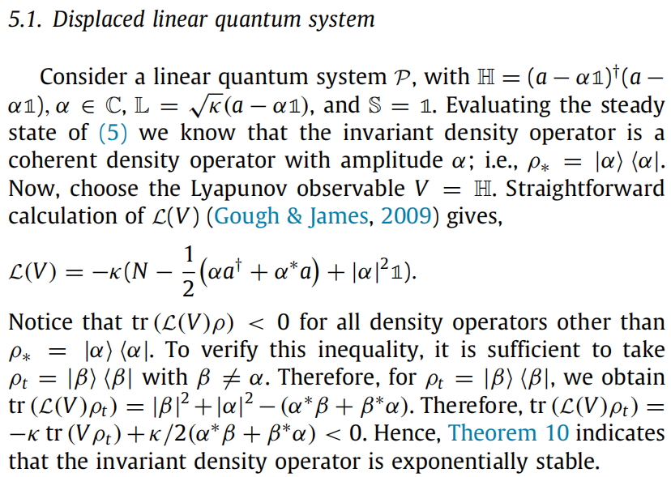
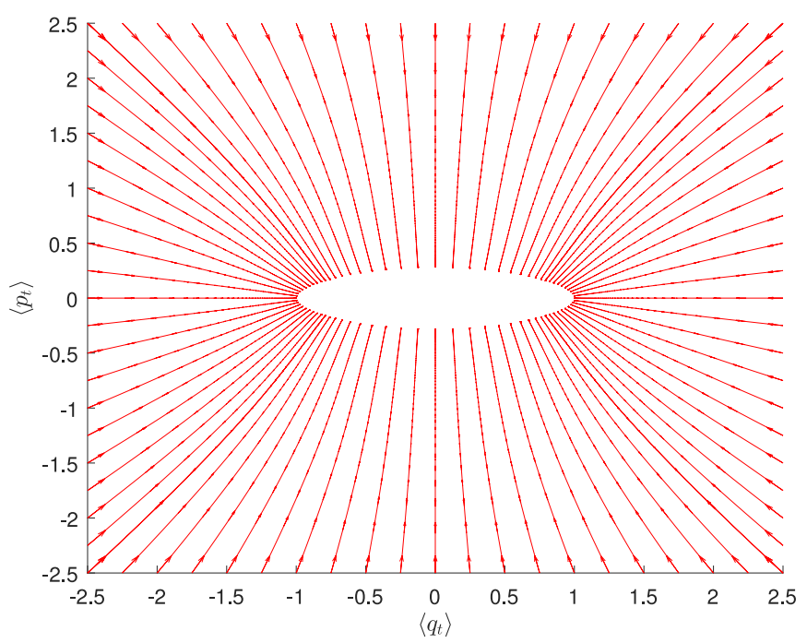
Method Design
CPS Computational Learning Laboratory

Slide 33
01
Problem Description
02
Method Design
03
Experiment Results
Contents
04
Conclusion
CPS Computational Learning Laboratory
CPS Computational Learning Laboratory
2
18

Slide 34
Future Work
Contributions
The paper proposes a stability analysis framework based on Lyapunov's method for analyzing the convergence of density operators of open quantum systems, which provides a new theoretical tool for the control and stabilization of quantum systems.
Future Work
Further extends the application of Lyapunov stability theory to a wider range of quantum systems, including nonlinear, non-Markovian processes, and quantum systems in infinite-dimensional Hilbert spaces.
CPS Computational Learning Laboratory
Notes:
论文提出了一个基于Lyapunov方法的稳定性分析框架，用于分析开放量子系统的密度算符的收敛性，为量子系统的控制与稳定提供了新的理论工具。该框架不仅适用于线性量子系统，还能够扩展到非线性量子系统，有助于深入理解量子系统的稳定性特性。进一步拓展Lyapunov稳定性理论在更广泛的量子系统中的应用，包括非线性、隐马尔可夫过程以及无限维希尔伯特空间中的量子系统。

Slide 35
Paper 3
Learning to Learn Variational Quantum Algorithm
Rui Huang , Xiaoqing Tan , and Qingshan Xu
Publish Journal: TNNLS
Published Time: 2023
CPS Computational Learning Laboratory

Slide 36
01
Problem Description
02
Method Design
03
Experiment Results
Contents
04
Conclusion
CPS Computational Learning Laboratory
Notes:
主要分为以下四个部分

Slide 37
01
Problem Description
02
Method Design
03
Experiment Results
Contents
04
Conclusion
CPS Computational Learning Laboratory

Slide 38
Problem Description
Collaborative multi-view IB for flexible unsupervised representation learning
In this paper, we propose a meta-learning variational quantum algorithm (metaVQA), aiming to extend to larger system sizes and problem instances by optimizing small-scale quantum algorithms.
Challenge
Traditional VQA requires a large number of iterations and samples during the training process, which limits its application to large-scale quantum systems.
Method
The article proposes a meta-learning variational quantum algorithm (meta-VQA) that aids quantum computation by training classical recurrent units. The core idea of this approach is for the model to learn how to optimize the algorithmic parameters so that it can quickly adapt and find near-optimal solutions in new tasks.
CPS Computational Learning Laboratory
Notes:
我们提出了一种元学习变分量子算法（元VQA），通过优化小规模量子算法，旨在扩展到更大的系统规模和问题实例。整个算法受到门控循环单元的启发，该单元通常在自然语言处理任务中表现出色。其次，我们在TensorFlow Quantum（TFQ）处理器[21]上部署了一个元VQA实验，该实验是在近期处理器上实现的。实验包括循环单元构建、评估电路模型、变分样本和自适应学习率计算。我们比较并分析了目标能量和变分参数，结果显示我们的算法在学习能力方面优于VQE算法。重要的是，我们的实验表明，通过优化小规模量子算法，可以在更大系统规模上进行学习。
挑战：传统VQA在训练过程中需要大量的迭代和采样，这限制了其在大规模量子系统中的应用。meta-VQA通过引入元学习和自适应学习率，减少了所需的采样次数和迭代次数，提高了优化效率。文章展示了meta-VQA可以扩展到更大的系统规模和问题实例，这对于解决实际应用中的复杂问题至关重要。通过优化小规模量子算法，meta-VQA能够在更大的系统中找到近似最优解。
方法：文章提出了一种元学习变分量子算法（meta-VQA），通过训练经典的循环单元来辅助量子计算。这种方法的核心思想是让模型学会如何优化算法参数，从而在新的任务中快速适应并找到近似最优解。具体来说，就是利用循环单元处理之前的迭代信息，帮助VQA更高效地找到参数空间中的近似最优值。

Slide 39
01
Problem Description
02
Method Design
03
Experiment Results
Contents
04
Conclusion
CPS Computational Learning Laboratory
Notes:
研究现状

Slide 40
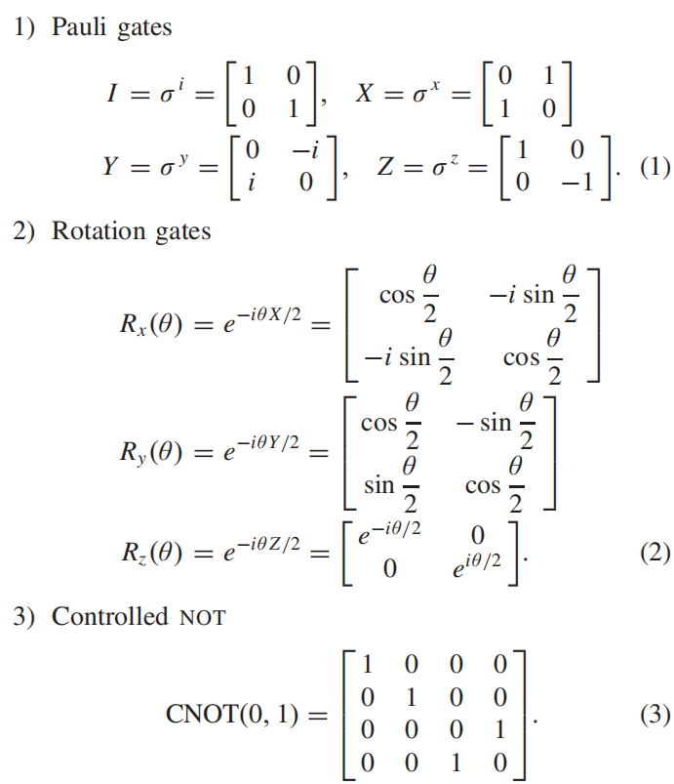
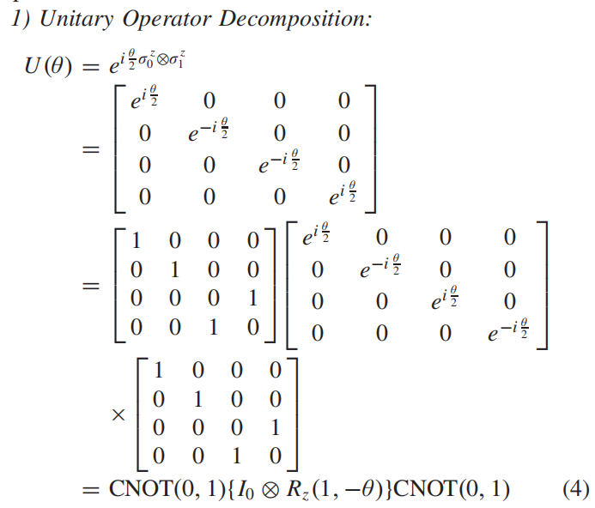
Method Design
（1）量子门编码
（2）量子电路实现量子态转换
注：通过Z旋转门和CNOT门实现量子态转换
CPS Computational Learning Laboratory

Slide 41
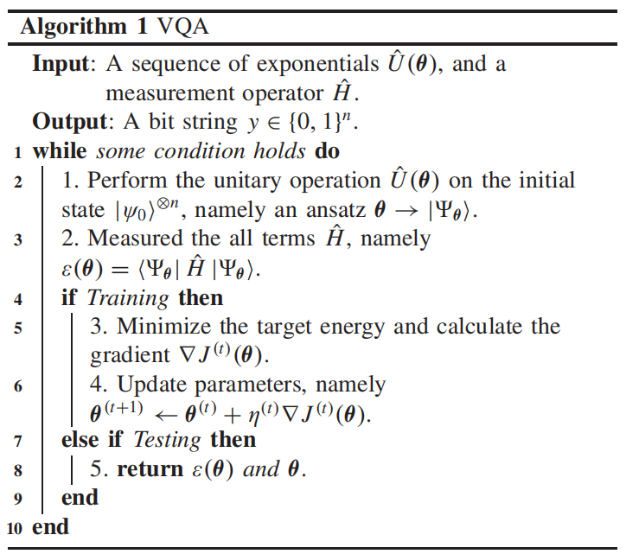
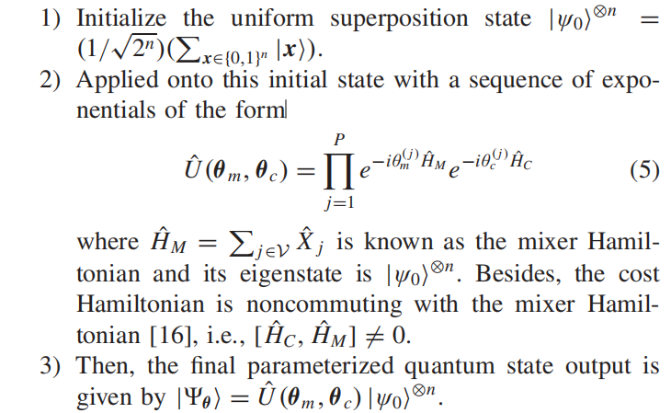
Method Design
（1）Variational quantum algorithms (VQA):
VQA uses classical computers as the quantum outer loop optimizer and updates the circuit parameters to approximate the ground state.
CPS Computational Learning Laboratory
Notes:
VQA使用经典计算作为外部优化

Slide 42
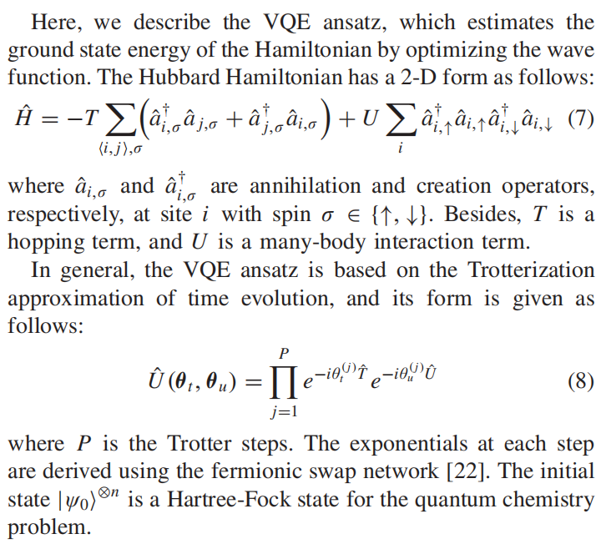
Method Design
（2）Variational Quantum Eigensolver (VQE):
假设：它通过优化波函数来估计哈密顿量的基态能量
注：公式（7）通过哈伯模型推导，通过trotter近似化为式（8）
补充：Trotterization approximation 是一种用于近似模拟量子系统时间演化的数值方法，它基于Trotter分解公式。该方法广泛应用于量子计算和量子模拟中，用于将复杂的哈密顿量演化分解为一系列更简单的、可操作的量子门操作。
CPS Computational Learning Laboratory
Notes:
将本征态线性叠加可以得到所有一般的态

Slide 43
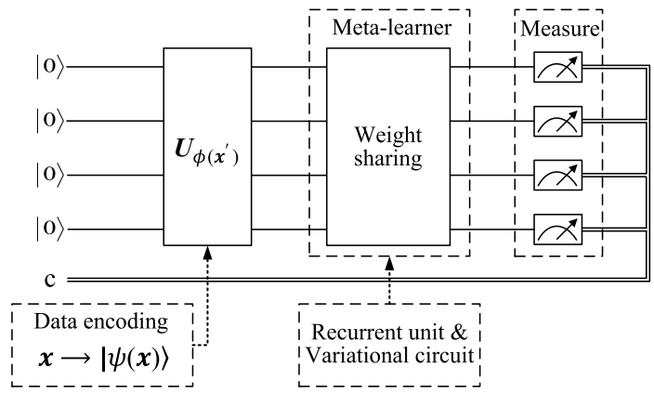
Method Design
①VQA by Energy Minimization Solver
CPS Computational Learning Laboratory
Notes:
传统VQA方法的整体流程如图所示。该方法分为三个阶段来实现VQA，即初始化假设、评估量子电路和梯度计算。总之，VQA是一种混合量子-经典算法，通过多次迭代优化变分电路参数以获得期望值。然而，需要注意的是，我们需要根据不同的问题场景进行多次迭代，且没有先验知识。
传统VQA方法的整体流程如算法1所示。该方法分为三个阶段来实现VQA，即初始化假设、评估量子电路和梯度计算。总之，VQA是一种混合量子-经典算法，通过多次迭代优化变分电路参数以获得期望值。然而，需要注意的是，我们需要根据不同的问题场景进行多次迭代，且没有先验知识。

Slide 44
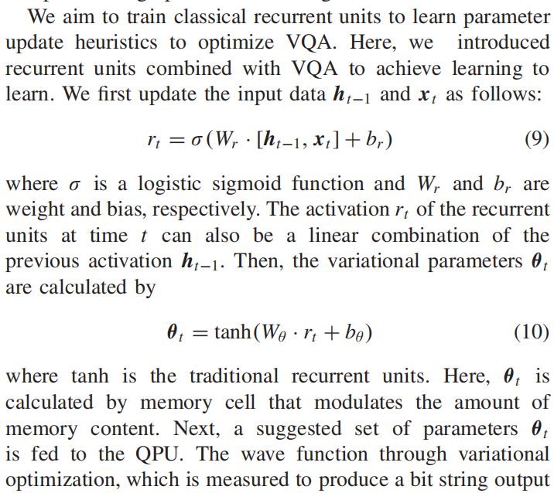
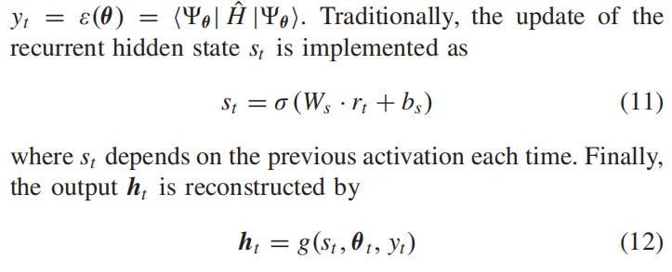

Method Design
② Mata-learning frameworks
CPS Computational Learning Laboratory

Slide 45



Method Design
③ Stochastic Gradient Descent
注：式（15）通过间接测量方法估计式（14）；
注：式（18）和式（19）根据生成器中的分布随机选择系数权重$γ_{k}$。
CPS Computational Learning Laboratory

Slide 46


Method Design
④ Adaptive Learning Rate
CPS Computational Learning Laboratory

Slide 47

Method Design
CPS Computational Learning Laboratory

Slide 48
01
Problem Description
02
Method Design
03
Experiment Results
Contents
04
Conclusion
CPS Computational Learning Laboratory

Slide 49


Experiment Results
A. Molecular Hydrogen
CPS Computational Learning Laboratory
Notes:
结果表明，meta-VQA生成的电路角度在相同的测试集中更接近目标值。在这种情况下，比较方法在优化模型和学习模型之间独立迭代，导致对输入数据缺乏适应性。

Slide 50



Experiment Results
B. Lithium Hydride
CPS Computational Learning Laboratory

Slide 51
01
Problem Description
02
Method Design
03
Experiment Results
Contents
04
Conclusion
CPS Computational Learning Laboratory
CPS Computational Learning Laboratory
2
18

Slide 52
Future Work
Contributions
This paper proposes the meta-VQA, which uses recurrent units to assist quantum computing and establishes a weight sharing method. It helps in learning to find approximate optimal in the parameter landscape more efficiently.
This paper introduces quantum stochastic gradient descent and an adaptive learning rate method to optimize parameters, reducing the sampling number and accelerating convergence.
Future Work
In the future, we will further study the coordinated implementation of meta-VQA distributed multiquantum devices, which may inspire investigations in the field of secure QML.
CPS Computational Learning Laboratory
Notes:
本文提出了元 VQA，它使用循环单元来辅助量子计算，并建立了一种权重共享方法。它有助于学习者更高效地找到参数优化·中的近似最优值。 并引入了量子随机梯度下降和自适应学习率方法来优化参数，减少了采样次数，加快了收敛速度。未来，我们将进一步研究meta-VQA分布式多量子器件的协同实现，这可能激发安全QML领域的研究。

Slide 53
Paper 4
Towards provably efficient quantum
algorithms for large-scale machinelearning models
Junyu Liu, Minzhao Liu, Jin-Peng Liu, Ziyu Ye
,
Yunfei Wang12, Yuri Alexeev2,3,8, Jens Eisert 13 & Liang Jiang
Published in: Nature Communication
Published Time: 2024
CPS Computational Learning Laboratory

Slide 54
01
Problem Description
02
Method Design
03
Experiment Results
Contents
04
Conclusion
CPS Computational Learning Laboratory
Notes:
主要分为以下四个部分

Slide 55
01
Problem Description
02
Method Design
03
Experiment Results
Contents
04
Conclusion
CPS Computational Learning Laboratory
Notes:
首先是问题描述

Slide 56
Problem Description
In this work, we show that quantum computing could possibly provide provably efficient resolutions for generic stochastic gradient descent algorithms. In practice, we benchmark instances of large machine learning models from 7 million to 103 million parameters. We find in the context of sparse training, a quantum enhancement is possible at the early stage of learning after model pruning, motivating a sparse parameter download and re-upload scheme.
Method:
This paper Linearization using quantum Carleman linearization method to linearization the nonlinear gradient descent process to an infinite-dimensional system of linear equations, followed by truncation to accommodate the solution of digital quantum systems. Afterwards, a variant of the HHL algorithm is used to solve the matrix inverse problem after linearization, thus enabling the solution of gradient descent dynamics on a quantum computer.
CPS Computational Learning Laboratory
Notes:
在实践中，我们对从 700 万到 1.03 亿个参数的大型机器学习模型实例进行了基准测试。我们发现，在稀疏训练的背景下，经过模型剪枝后，量子增强在学习的早期阶段是可能的，这激发了一种稀疏参数下载和重新上传方案。
本文利用量子Carleman线性化将非线性梯度下降过程线性化，转换为无限维的线性方程组，然后通过截断来适应数字量子系统的求解。之后利用变体的HHL算法解决线性化后的矩阵求逆问题，从而在量子计算机上实现梯度下降 dynamics 的求解。

Slide 57
01
Problem Description
02
Method Design
03
Experiment Results
Contents
04
Conclusion
CPS Computational Learning Laboratory
Notes:
研究现状

Slide 58

Method Design
注：量子计算的时间复杂度上界定理
CPS Computational Learning Laboratory
Notes:
时间复杂度的定理为提出的量子算法提供了理论上的性能保证。通过展示算法在时间复杂度上的优势，可以证明该算法在处理大规模机器学习模型时的潜在效率.

Slide 59




Method Design
(1) Nonlinear stochastic gradient descent
注： HHL算法是一种用于求解线性方程组的量子算法。即在定理1的基础上，可以保证在时间复杂度
下实现求解 n×n 稀疏矩阵的逆问题。
(2) quantum Carleman linearization
CPS Computational Learning Laboratory
Notes:
通过量子Carleman线性化，非线性递归关系被转换为一个无限维的线性方程组。为了在数字量子系统上求解这个无限维的线性方程组，需要进行截断。对于稀疏且耗散的系统，截断误差可以被很好地控制。最终，这个线性方程组可以表示为一个矩阵求逆问题，从而可以使用HHL算法在量子计算机上求解。

Slide 60
01
Problem Description
02
Method Design
03
Experiment Results
Contents
04
Conclusion
CPS Computational Learning Laboratory

Slide 61


Method Design
First, we study a model with 7 million trainable parameters trained to distinguish images of 100 classes. We first pre-train the neural network, use the largest 10% of learned parameters for initialization, and use the quantum ODE system to obtain a sparse output model. We record the Hessian spectra during sparse training, allowing us to track the evolution of an error bound related quantity, given by：
CPS Computational Learning Laboratory

Slide 62
01
Problem Description
02
Method Design
03
Experiment Results
Contents
04
Conclusion
CPS Computational Learning Laboratory
CPS Computational Learning Laboratory
2
18

Slide 63
Future Work
Contributions
This paper presents a quantum algorithm designed to enhance the efficiency of large-scale machine learning models. First demonstrate quantum computing can potentially provide efficient solutions for gradient descent algorithms. This is achieved by leveraging quantum Carleman linearization to convert the non-linear gradient descent process into a linear system, which can then be solved using quantum linear system solvers like the HHL algorithm.
Future Work
The future will include theoretical improvements on the truncated HHL algorithms and the
identification of mechanisms of possible quantum speedups beyond notions of dissipation.
CPS Computational Learning Laboratory
Notes:
本文介绍了一种新型量子算法，旨在提高大规模机器学习模型的效率。首先证明量子计算有可能为梯度下降算法提供高效的解决方案。这是通过利用量子卡勒曼线性化将非线性梯度下降过程转换为线性系统来实现的，然后可以使用量子线性系统求解器（如 HHL 算法）来求解。
未来研究包括在梯度下降轨迹中开发替代的时间依赖版本，识别更好的耗散形式标准，探讨与经典机器学习和语言模型中的扩散模型的联系，对截断HHL算法的理论改进，以及识别超越耗散概念的可能量子加速机制。

Slide 64
Paper 5
Entanglement-Controlled Quantum Federated
Learning
Héctor Ríos , Alejandra Ferreira de Loza , Denis Efimov and Roberto Franco
Publish Journal: IEEE Internet of Things Journal
Published Time: 2025
CPS Computational Learning Laboratory

Slide 65
01
Problem Description
02
Method Design
03
Experiment Results
Contents
04
Conclusion
CPS Computational Learning Laboratory
Notes:
主要分为以下四个部分

Slide 66
01
Problem Description
02
Method Design
03
Experiment Results
Contents
04
Conclusion
CPS Computational Learning Laboratory
Notes:
首先是问题描述

Slide 67
Problem Description
entangled slimmable quantum federated learning(eSQFL)
This paper presents an entangled slimmable quantum federated learning (eSQFL) framework designed for efficient communication under varying channel conditions. It introduces entangled slimmable quantum neural networks (eSQNNs) that use controlled universal (CU) gates to manage entanglement levels and reduce entropy. The framework employs superposition coding and an inplace fidelity distillation (IPFD) regularizer to handle inter-depth interference and optimize parameter exchange. Through extensive simulations, the paper shows that eSQFL outperforms traditional QFL methods in prediction accuracy and robustness across different channel conditions and data distributions.
CPS Computational Learning Laboratory
Notes:
本文提出了一种纠缠量子联合学习（eSQFL）框架，旨在实现不同信道条件下的高效通信。它引入了纠缠量子神经网络（eSQNN），使用受控通用（CU）门来管理纠缠水平并降低熵。该框架采用叠加编码和就地保真蒸馏（IPFD）正则器来处理深度间干扰并优化参数交换。通过大量仿真，论文表明 eSQFL 在不同信道条件和数据分布下的预测精度和鲁棒性优于传统 QFL 方法。

Slide 68
01
Problem Description
02
Method Design
03
Experiment Results
Contents
04
Conclusion
CPS Computational Learning Laboratory
Notes:
研究现状

Slide 69





Method Design
CPS Computational Learning Laboratory
Notes:
表示由时间相关的外部扰动组成的非线性扰动和非线性非建模动力学

Slide 70


Method Design
CPS Computational Learning Laboratory
Notes:
表示由时间相关的外部扰动组成的非线性扰动和非线性非建模动力学

Slide 71


Method Design
CPS Computational Learning Laboratory
Notes:
这些方程定义了纠缠可纤细量子联合学习（eSQFL）框架内的本地训练过程。它们概述了本地设备如何计算和更新参数，并结合了就地保真蒸馏（IPFD）正则器，以确保有效训练纠缠可纤微量子神经网络（eSQNN）。总之，这些方程对于在 eSQFL 框架内实现 eSQNNs 的训练过程至关重要。它们能确保本地设备高效地训练其量子神经网络，同时保持不同层量子态的保真度。这有助于在各种信道条件和数据分布下实现更好的预测精度和鲁棒性。

Slide 72


Method Design
Convergence analysis
CPS Computational Learning Laboratory
Notes:
全局模型的目标函数和局部目标函数分别记为F和{F k}。用条形符号¯·表示对{ζt k}的平均值，上标∗表示最优解。
第一个假设确保了损失函数的平滑性
第二个假设确保了损失函数的凸性
第三个假设确保了局部梯度在不同设备上不会有太大差异。梯度方差受限对于确保梯度估计中的噪声不会主导优化过程非常重要，否则会导致发散或收敛缓慢。

Slide 73


Method Design
注：定理1确保了目标函数会依分布收敛于最优解。同时证明了收敛速率会受学习率 、强凸参数 、平滑参数以及梯度的方差等多因素影响
CPS Computational Learning Laboratory

Slide 74
01
Problem Description
02
Method Design
03
Experiment Results
Contents
04
Conclusion
CPS Computational Learning Laboratory

Slide 75

Experiment Results
Experimental training parameter Design
CPS Computational Learning Laboratory

Slide 76

Experiment Results
注：图4和图5展示了eSQFL在不同信噪比（SNR）和不同非独立同分布（non-IID）数据分布下的性能表现。
CPS Computational Learning Laboratory
Notes:
图四展示了在不同平均信噪比（SNR）条件下，eSQFL的不同层次（eSQFL-L1、eSQFL-L2、eSQFL-L3）的Top-1准确率。可以看出随着信噪比从11 dB增加到19 dB，eSQFL的所有层次的解码成功率和Top-1准确率都有所提高。
图五展示了在不同非独立同分布（non-IID）数据分布（由Dirichlet浓度参数α控制）下，eSQFL和对比模型（如Vanilla QFL）的Top-1准确率。

Slide 77


Experiment Results
CPS Computational Learning Laboratory

Slide 78
01
Problem Description
02
Method Design
03
Experiment Results
Contents
04
Conclusion
CPS Computational Learning Laboratory
CPS Computational Learning Laboratory
2
18

Slide 79
Conclusion
Contributions
The paper makes several key contributions to the field of quantum federated learning. First introduces a novel architecture for entangled slimmable quantum neural networks (eSQNNs), which allows for depth-controllable quantum neural networks and effective management of entanglement levels through controlled universal (CU) gates. Second, this paper provides a rigorous convergence analysis of the eSQFL algorithm and validates its superior performance through extensive simulations, demonstrating improved prediction accuracy and robustness compared to existing methods under different channel conditions and data distributions.
CPS Computational Learning Laboratory
Notes:
本文对量子联合学习领域做出了几项重要贡献。首先，本文介绍了一种新颖的纠缠可纤细量子神经网络（eSQNN）架构，它允许深度可控的量子神经网络，并通过受控通用（CU）门有效管理纠缠水平。其次，本文对 eSQFL 算法进行了严格的收敛性分析，并通过大量仿真验证了该算法的优越性能，表明在不同信道条件和数据分布下，该算法的预测精度和鲁棒性均优于现有方法。

Slide 80
Inspiration
In the future, the work will consider the quantum stochastic gradient descent method to improve the convergence speed of the optimization process in order to enhance the reliability of adaptive state estimation. At the same time, we will try to combine QNN with Kalman filters and generalize this to distributed systems and deriving estimation optimality from consistency.
CPS Computational Learning Laboratory

Slide 81
Thank you for listening

